Slide 1


SMART INDIA HACKATHON 2024
TITLE PAGE
Problem Statement ID- 1599
Problem Statement Title- Student Innovation
Theme- Fitness&Sports
PS Category- Software
Team ID-
Team Name (Registered on portal)- DenQueue

Slide 2
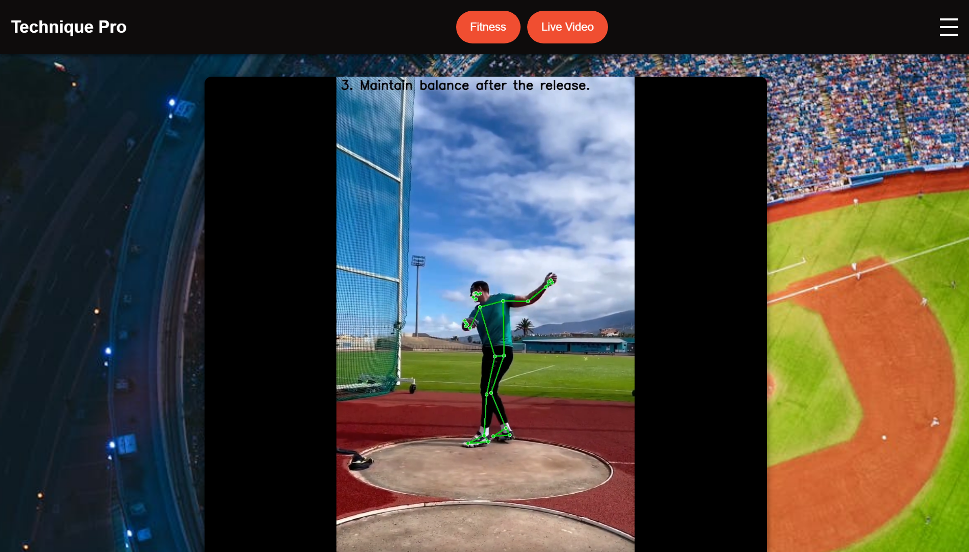
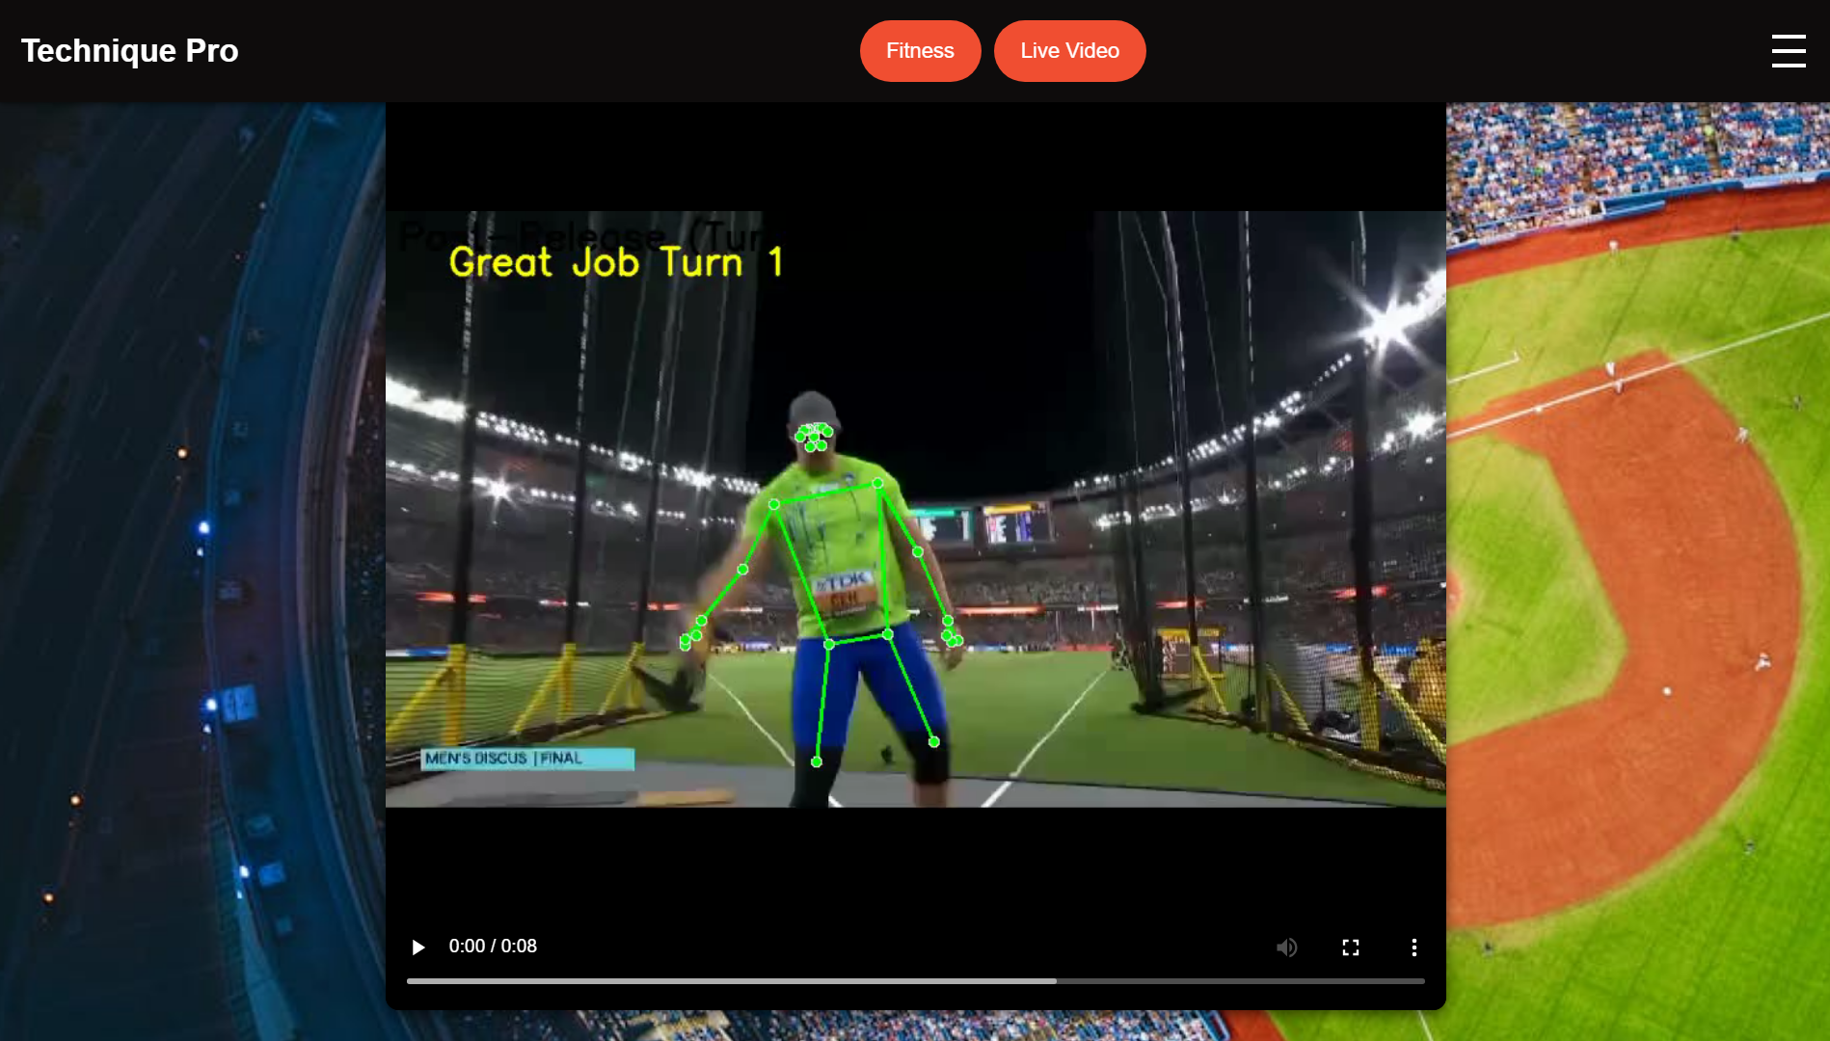
Technique-pro
DenQueue
Provides real time tracking, analysis,
and feedback for athletic activities.
Instant chatbot support for athletes
dealing with injuries.
Personalized fitness exercises
tailored to each individual.
Track weekly athletic progress with
charts comparing to world records
and personal bests.
Prototype

Slide 3
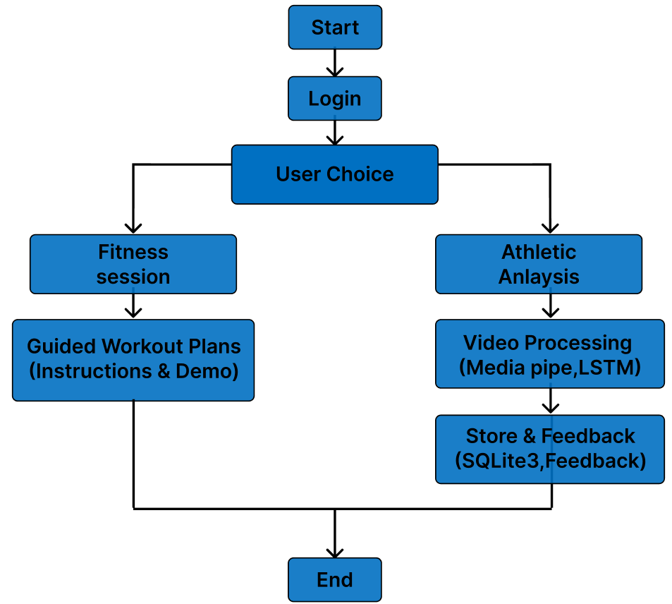
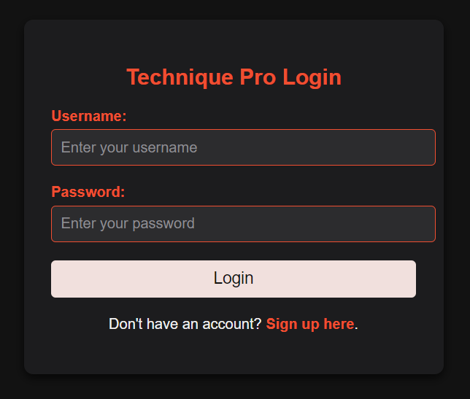
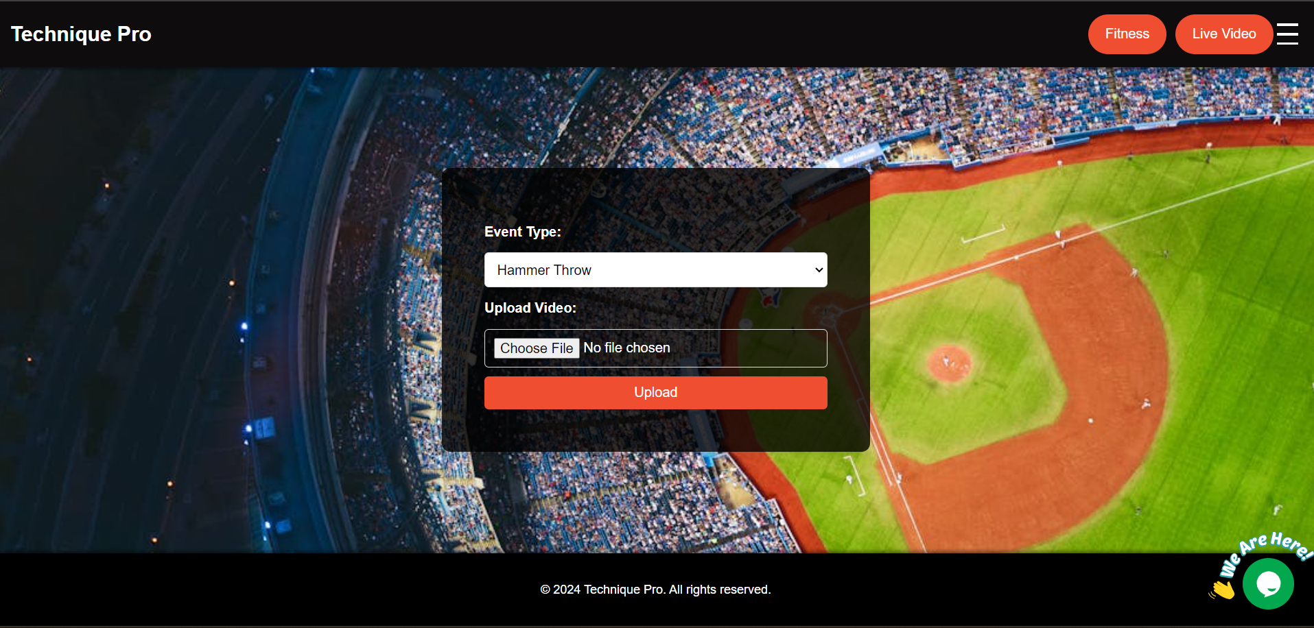
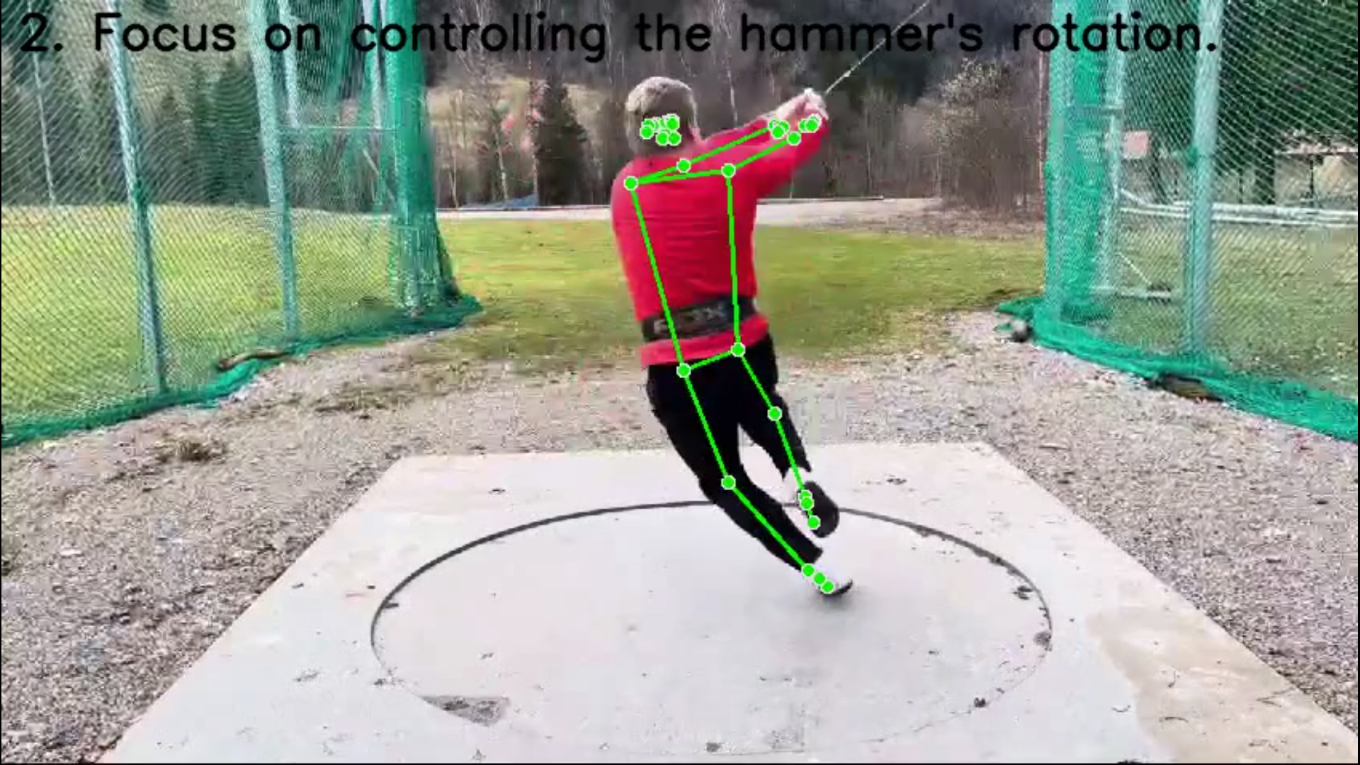
TECHNICAL APPROACH
DenQueue
Frontend: HTML
CSS, JavaScript
Backend: Flask
(Python)
ML: TensorFlow,
Keras, Rasa
DL: MediaPipe
Database: SQLite3
Tech Stack
Flow Chart
Prototype

Slide 4
FEASIBILITY AND VIABILITY
DenQueue
Feasibility:
Proven AI: Utilizes established models with TensorFlow
and Keras.
Scalable Stack: Flask, TensorFlow, Rasa and SQLite3
allow for easy scaling.
Extensible Design: Modular and adaptable architecture for easy future enhancements.
Viability:
Market Demand: High potential; major centers like NIS,
IIS, and Reliance Sports Foundation likely to adopt.
Revenue Model: Potential for subscription-based
or premium features.

Slide 5
IMPACT AND BENEFITS
DenQueue
Impact on Audience:
User-Centered: Coach feedback shaped platform design.
Performance Improvement: Real-time feedback accelerate skill development, with instant chatbot support
for injury advice and recovery.
Benefits:
Practical Solutions: Addresses real-world athletic
challenges with actionable insights.
Targeted Guidance: Provides personalized support for
injury prevention and recovery, tailored to athletes' needs.
Enhanced Performance: Provides targeted feedback to improve training outcomes.

Slide 6
RESEARCH AND REFERENCES
DenQueue
Research:
Coach Consultation: We interviewed state and national-level coaches to gain practical insights and feedback on athletic performance tracking.
Personal Insight: Developed the platform based on firsthand experience as an athlete who faced a lack of coaching resources, ensuring it addresses critical gaps in athletic support.
References
TrainingPeaks - https://home.trainingpeaks.com/
Description: Offers tools and resources for performance tracking and training optimization.

